Slide 1

AVL Trees
Rem Collier
Room A1.02
School of Computer Science and Informatics
University College Dublin, Ireland

Slide 2
Quick Recap
Trees are Hierarchical ADT’s in which data is defined in terms of parent and child relationships between nodes.
  A Proper Binary Tree is a Tree in which each node has either 0 (external) or 2 (internal) children.
  A Binary Search Tree is a Binary Tree that holds values whose location is determined by a total order relation.
  Binary Search Trees are another approach to implementing Maps and Dictionaries that have best case performance O(log n).
  Performance depends on the height of the tree, and is best when the tree is balanced.

Slide 3
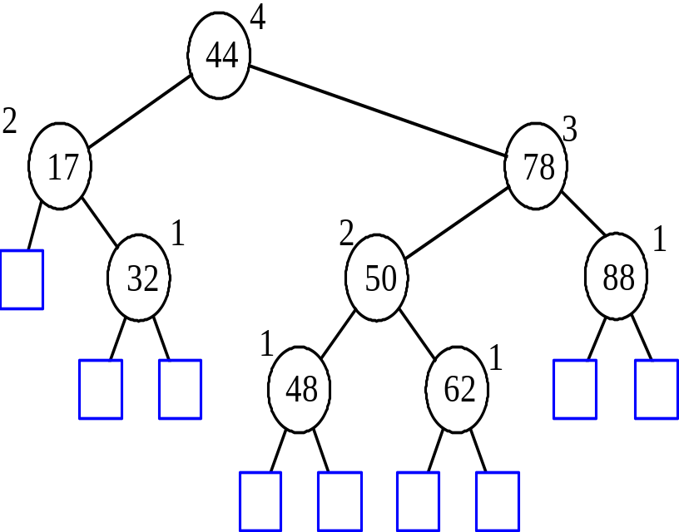
AVL Tree Definition
AVL trees are an example of a self-balancing binary search tree.
  Named after inventors - Adelson-Velsky and Landis - in 1962.
AVL trees must satisfy the height-balance property:
  For every internal node v of T, the heights of the children of v can differ by at most 1.
AVL trees have expected performance O(log n).
An example of an AVL tree where the heights are shown next to the nodes.

Slide 4
Insertion in an AVL Tree
AVL trees are binary trees.
  Insertion is the same as in a binary search tree.
  We simply locate the relevant external node and expand it.
Because AVL trees are balanced:
  The expected performance of this operation is O(log n)
Example: Add 62 to this tree…
44
17
78
32
50
88
48

Slide 5
Insertion in an AVL Tree
AVL trees are binary trees.
  Insertion is the same as in a binary search tree.
  We simply locate the relevant external node and expand it.
Because AVL trees are balanced:
  The expected performance of this operation is O(log n)
Example: Add 62 to this tree…
44
17
78
32
50
88
48
62

Slide 6
Insertion in an AVL Tree
The key difference is that, after insertion, we must check that the height-balance property still holds.
  To do this, we search upwards from the newly inserted node.
  For each node we visit, we compare the height of its children.
  If the difference in height between the two children is greater than 1, the tree is said to be unbalanced!.
44
17
78
2
32
50
88
1
1
48
62

Slide 7
Insertion in an AVL Tree
The key difference is that, after insertion, we must check that the height-balance property still holds.
  To do this, we search upwards from the newly inserted node.
  For each node we visit, we compare the height of its children.
  If the difference in height between the two children is greater than 1, the tree is said to be unbalanced!.
44
3
17
78
2
1
32
50
88
1
1
48
62

Slide 8
Insertion in an AVL Tree
The key difference is that, after insertion, we must check that the height-balance property still holds.
  To do this, we search upwards from the newly inserted node.
  For each node we visit, we compare the height of its children.
  If the difference in height between the two children is greater than 1, the tree is said to be unbalanced!.
4
44
2
3
17
78
2
1
32
50
88
1
1
48
62
The tree is balanced!

Slide 9
Insertion in an AVL Tree
Lets have another go by inserting 54:
44
17
78
32
50
88
48
62

Slide 10
Insertion in an AVL Tree
Now, we do the balance check:
44
17
78
32
50
88
48
62
54

Slide 11
Insertion in an AVL Tree
Now, we do the balance check:
44
Unbalanced Node!
17
78
3
1
32
50
88
1
2
48
62
1
54

Slide 12
Insertion in an AVL Tree
Let z be the first unbalanced node encountered while travelling up the tree from the newly inserted node.
Also, let y be the child of z with the larger height, and let x be the child of y with the larger height.
Lets apply this labeling to the previous example.
44
17
78
3
1
32
50
88
1
2
48
62
1
54

Slide 13
Insertion in an AVL Tree
Because z is imbalanced, we invoke the restructure(x) operation.
  This operation performs a re-stucturing of the sub tree rooted at z.
  We pass in x because it is easy to work out y and z.
  The restructuring process is known as trinode restructuring.
After restructuring, we continue checking for unbalanced nodes until we reach the root.
44
z
17
78
y
32
50
88
x
48
62
54

Slide 14
Trinode Restructuring
let (a,b,c) be an inorder listing of x, y, z
perform the rotations needed to make b the topmost node of the three
(other two cases are symmetrical)
a=z
a=z
case 2: double rotation
(a right rotation about c, then a left rotation about a)
T₀
T₀
c=y
b=y
T₁
b=x
T₃
c=x
T₂
T₃
b=y
T₁
T₂
b=x
a=z
c=x
a=z
c=y
T₀
T₁
T₂
T₃
T₀
T₁
T₂
T₃
case 1: single rotation
(a left rotation about a)

Slide 15
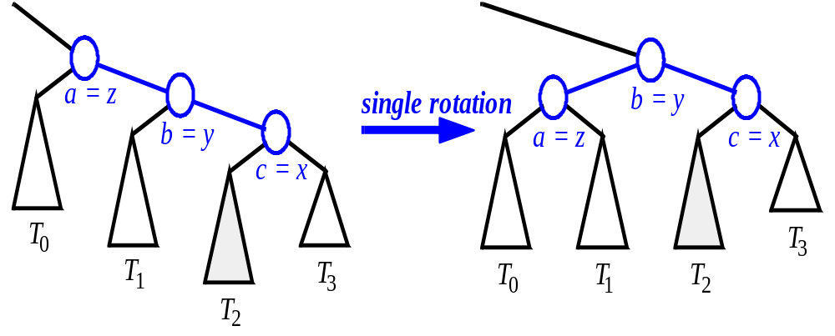
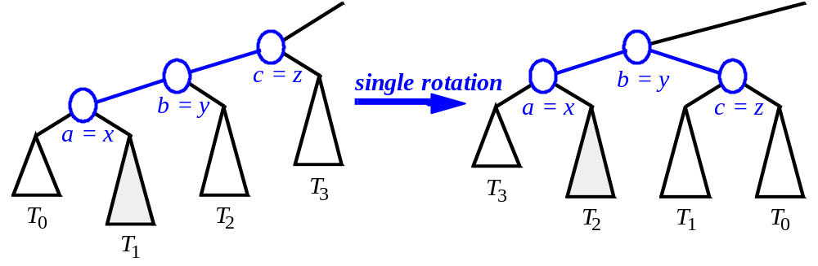
Single Rotations

Slide 16
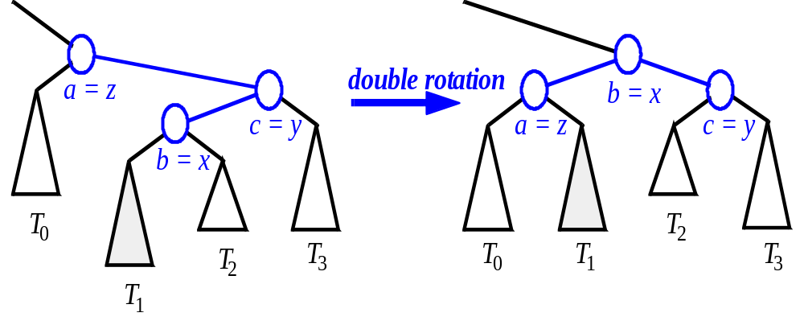
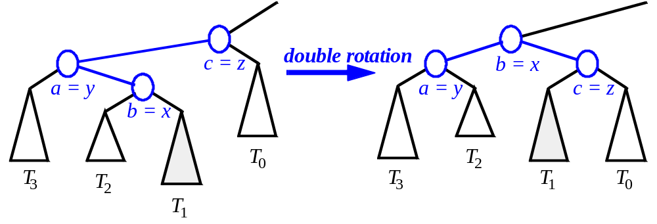
Double Rotations

Slide 17
Insertion in an AVL Tree
To restructure the tree rooted at z, we must perform a double rotation.
44
c=z
17
78
a=y
32
50
88
b=x
48
62
54

Slide 18
Insertion in an AVL Tree
To restructure the tree rooted at z, we must perform a double rotation.
44
c
17
78
a
32
50
88
b
48
62
T₀
54
T₁
T₃
T₂

Slide 19
Insertion in an AVL Tree
To restructure the tree rooted at z, we must perform a double rotation.
44
b
17
62
c
a
32
50
78
48
54
88
T₁
T₃
T₂
T₀

Slide 20
Insertion in an AVL Tree
To restructure the tree rooted at z, we must perform a double rotation.
The tree rooted at z has now been balanced by restructuring it as a tree that is rooted at x!
44
3
17
62
2
2
32
50
78
48
54
88

Slide 21
Removal from an AVL Tree
Removal begins as in a binary search tree, which means the node removed will become an empty external node.
  In contrast with insertion, it’s parent, w, becomes the starting point for performing the balance check.
Example: Delete 32 from the following tree
44
17
62
32
50
78
48
54
88

Slide 22
Removal from an AVL Tree
Removal begins as in a binary search tree, which means the node removed will become an empty external node.
  In contrast with insertion, it’s parent, w, becomes the starting point for performing the balance check.
Example: Delete 32 from the following tree
44
17
62
50
78
48
54
88

Slide 23
Removal from an AVL Tree
Removal begins as in a binary search tree, which means the node removed will become an empty external node.
  In contrast with insertion, it’s parent, w, becomes the starting point for performing the balance check.
Example: Now search for an imbalance…
44
Unbalanced Node!
1
3
17
62
50
78
48
54
88

Slide 24
Rebalancing after a Removal
Let z be the first unbalanced node encountered while traveling up the tree from w,
  Also, let y be the child of z with the larger height, and let x be the child of y with the larger height.
  We perform restructure(x) to restore balance at z.
z
62
44
y
44
78
17
62
x
17
50
88
50
78
48
54
48
54
88

Slide 25
Rebalancing after a Removal
As this restructuring may upset the balance of another node higher in the tree, we must continue checking for balance until the root of T is reached…
In this case, 62 is the root, so we have balanced the tree!
62
44
78
17
50
88
48
54

Slide 26
Height of an AVL Tree
Fact: The height of an AVL tree storing n keys is O(log n).
Proof: Let us bound n(h): the minimum number of internal nodes of an AVL tree of height h.
We easily see that n(1) = 1 and n(2) = 2
For h > 2, an AVL tree of height h contains the root node, one AVL sub-tree of height h-1 and another of height h-2.
That is:
n(h) = 1 + n(h-1) + n(h-2) (1)
n(2)
3
4
n(1)

Slide 27
Height of an AVL Tree
Our equation for n is a strictly increasing function of h.
This means that:
n(h-1) > n(h-2)
By replacing n(h-1) with n(h-2) in (1) we get:
n(h) > 2 x n(h-2) (2)
It then follows that:
  n(h) > 4n(h-4)
  n(h) > 8n(h-6)
  …
  n(h) > 2^{i}n(h-2i) (3)

Slide 28
Height of an AVL Tree
Now, we need to solve for a base case:
We can make a substitution into (3) if we know a value for n(h-2i).
But, we know values for n(1) and n(2)…
Lets use the value for n(2). This means that:
h – 2i = 2
Which, itself can be re-written as:
i = (h/2) - 1

Slide 29
Height of an AVL Tree
Plugging our value of i into the inequality for n(h) gives us:
n(h) > 2^{(h/2)-1}. n (h – 2 . ( (h/2) – 1 ) )
n(h) > 2^{(h/2)-1}. n (h – 2 (h/2) + 2 )
n(h) > 2 ^{(h/2)-1} .n(2) where n(2) = 2
n(h) > 2 ^{(h/2)-1} . 2
n(h) > 2 ^{(h/2)}
Taking logarithms:
log n(h) > log ( 2 ^{(h/2)} )
log n(h) > h/2
h < 2. log n(h)
Thus the height of an AVL tree is O(log n)!

Slide 30
Running Times for AVL Trees
a single restructure is O(1) as we are using a linked-structure binary tree.
find is O(log n)
  height of tree is O(log n), no restructures needed
insert is O(log n)
  initial find is O(log n)
  Rebalancing the tree is O(log n)
remove is O(log n)
  initial find is O(log n)
  Rebalancing the tree is O(log n)

Slide 31
Problems
Create the following BST:
  insert(15), insert(25), insert(5), insert(9), remove(15)
  insert(37), insert(26), insert(35), insert(28), remove(26)
  insert(40), insert(1), insert(15), insert(26), insert(6), remove(5)
Create the following BST:
  insert(H), insert(A), insert(P), insert(Y), insert(O), remove(H)
  insert(B), insert(C), insert(F), insert(E), remove(A)
  insert(H), insert(A)

